Slide 1
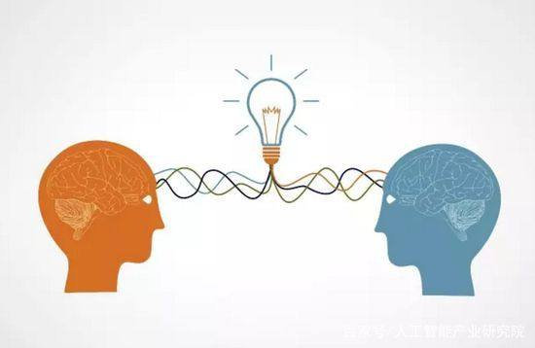
Transfer Learning

Slide 2
CONTENT:
OUR METHOD
EXPERIMENT

Slide 3
Our method
Domain Adaptation with Few Labeled Source Samples by Graph Regularization
Hypothesis:
Source domain: large-scale data with few label information
Target domain: unlabeled data
Framework:
$f^{∗}={argmin}_{Θ}\frac{1}{l}\sum_{i=1}^{i}{V\left(x_{i},y_{i},f\right)+γ_{A}}{\left\|f\right\|}_{2}^{2}+\frac{γ_{B}}{{\left(u+l\right)}^{2}} \sum_{i,j=1}^{u+l}{{\left(f\left(x_{i}\right)−f\left(x_{j}\right)\right)}^{2}W_{i,j}+ γ_{C}{MMD}^{2}}\left(ΘX_{src},ΘX_{tar}\right)$

Slide 4
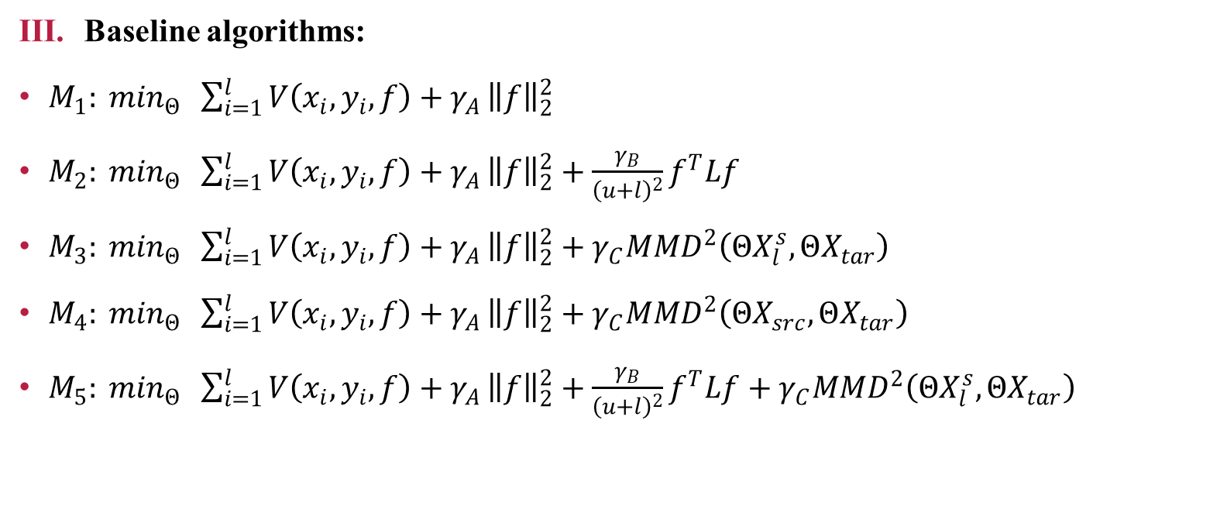
Our method
Baseline algorithms:
$M_{1}: \min_{Θ} \sum_{i=1}^{l}{V\left(x_{i},y_{i},f\right)+γ_{A}}{\left\|f\right\|}_{2}^{2}$
$M_{2}: \min_{Θ} \sum_{i=1}^{l}{V\left(x_{i},y_{i},f\right)+γ_{A}}{\left\|f\right\|}_{2}^{2}+\frac{γ_{B}}{{\left(u+l\right)}^{2}}f^{T}Lf$
$M_{3}: \min_{Θ} \sum_{i=1}^{l}{V\left(x_{i},y_{i},f\right)+γ_{A}}{\left\|f\right\|}_{2}^{2}+γ_{C}{MMD}^{2}\left(ΘX_{l}^{s},ΘX_{tar}\right)$
$M_{4}: \min_{Θ} \sum_{i=1}^{l}{V\left(x_{i},y_{i},f\right)+γ_{A}}{\left\|f\right\|}_{2}^{2}+γ_{C}{MMD}^{2}\left(ΘX_{src},ΘX_{tar}\right)$
$M_{5}: \min_{Θ} \sum_{i=1}^{l}{V\left(x_{i},y_{i},f\right)+γ_{A}}{\left\|f\right\|}_{2}^{2}+\frac{γ_{B}}{{\left(u+l\right)}^{2}}f^{T}Lf+γ_{C}{MMD}^{2}\left(ΘX_{l}^{s},ΘX_{tar}\right)$

Slide 5
Our method
MMD

Slide 6
Our method
The unbiased estimate of MMD is obtained by drawing pairs from source and target domain.
A. Gretton, K. Borgwardt, M. Rasch, B. Scholkopf, and A. Smola, “A kernel two-sample test,” J. Mach. Learn. Res. (JMLR), vol. 13, pp. 723–773, Mar. 2012

Slide 7
EXPERIMENT
Dataset | Type | Examples | Features | Classes | Subset
MNIST | Digit | 1800 | 256 | 10 | MNIST
USPS | Digit | 2000 | 256 | 10 | USPS
COIL20 | Object | 1440 | 1024 | 20 | COIL1 COIL2
Office | Object | 1410 | 800 | 10 | A, W, D
Caltech | Object | 1123 | 800 | 10 | C

Slide 8
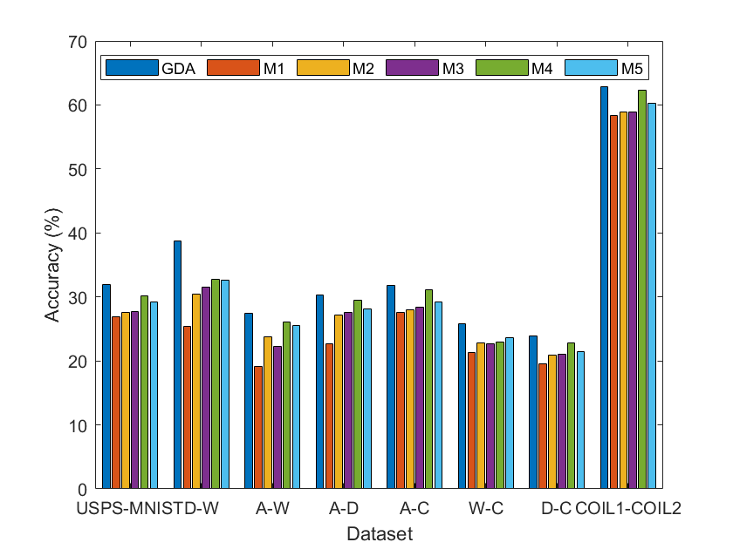
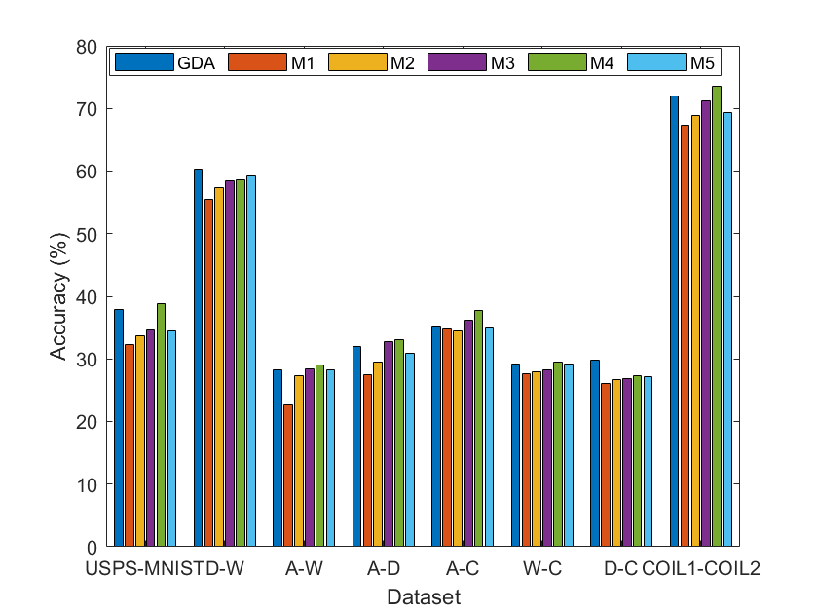
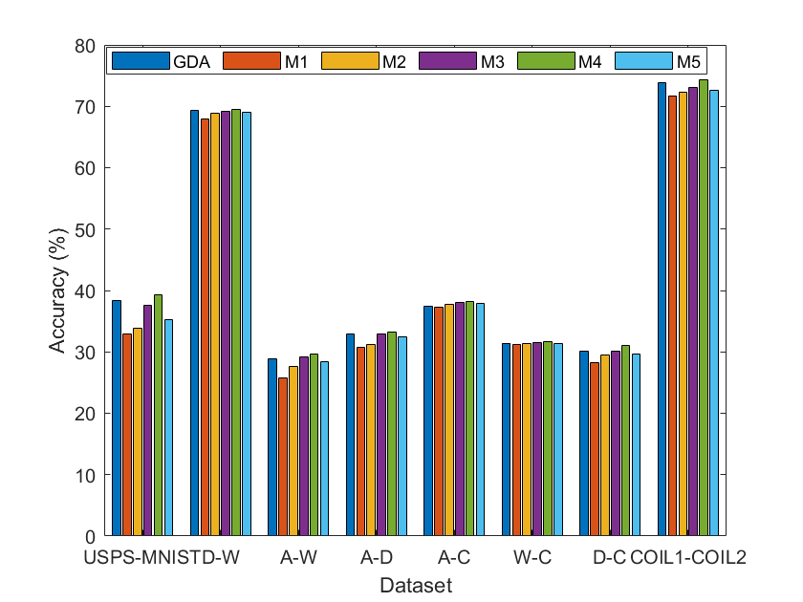
EXPERIMENT
$M_{1}$：$γ_{c}$ $γ_{b}$ zero; ${ M}_{2}:$ $γ_{c}$ zero; $M_{3}:γ_{b}$ zero; $M_{4}:$ $γ_{b}$ zero and only source labeled data; $M_{5}$：only source labeled data;

